Slide 1
Netflix: A stock profile
An exploration of 2017 stock performance

Slide 2
Overview
Hypothetically, working for Yahoo Finance as a data visualization expert I have put together a series of charts. Along with the team at Yahoo, we have created a stock profile for Netflix 2017 performance.
Visualizations
2017 Quarterly Distribution
2017 Quarterly Earning Per Share
2017 Quarterly Revenue and Earnings
Price Performance: Netflix and the Dow Jones

Slide 3
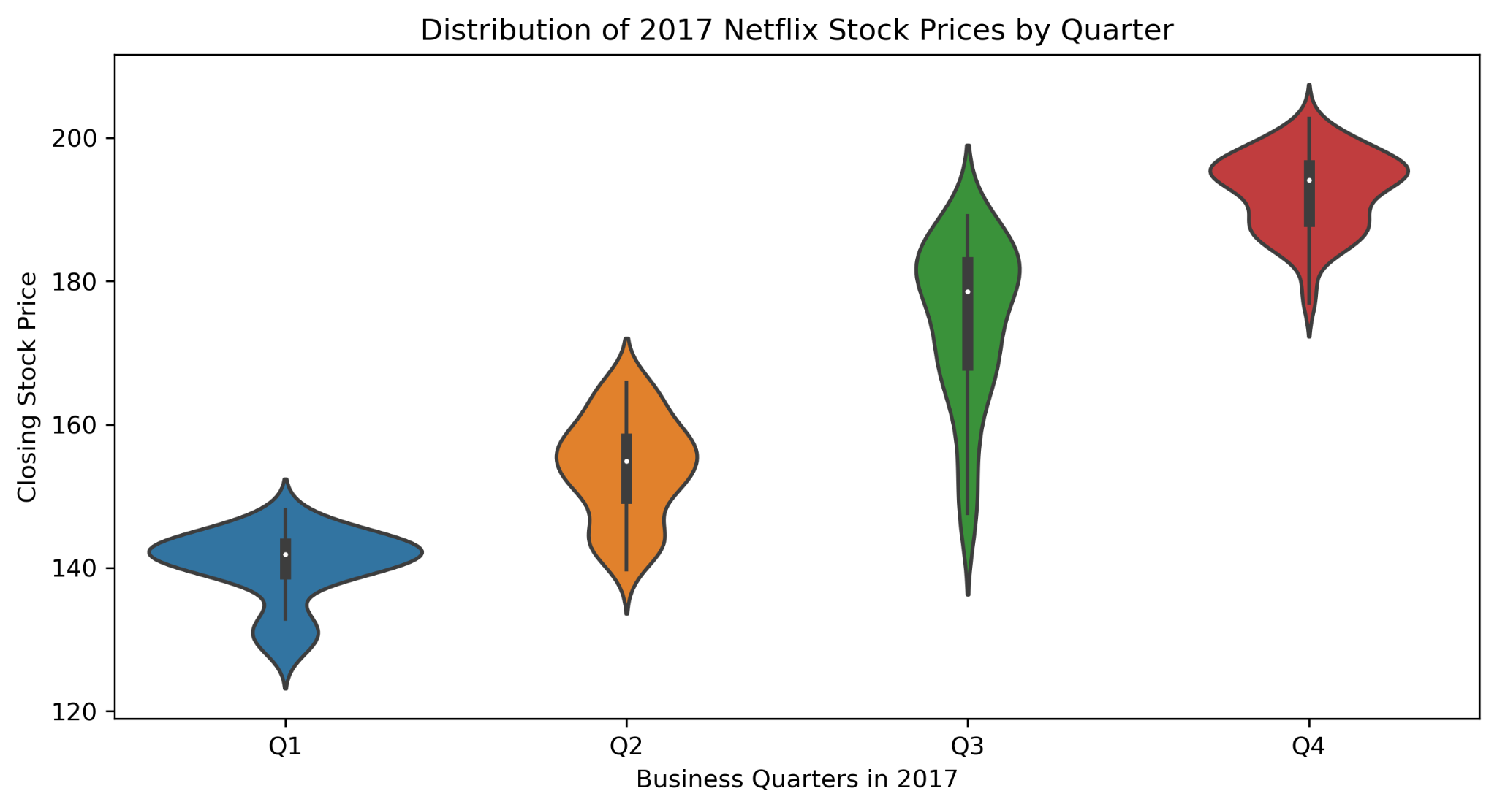
2017 Quarterly Distribution
Netflix trended up throughout the year, its price ranging from $127.49 - $202.68. With q3 prices exhibiting the widest distribution.

Slide 4
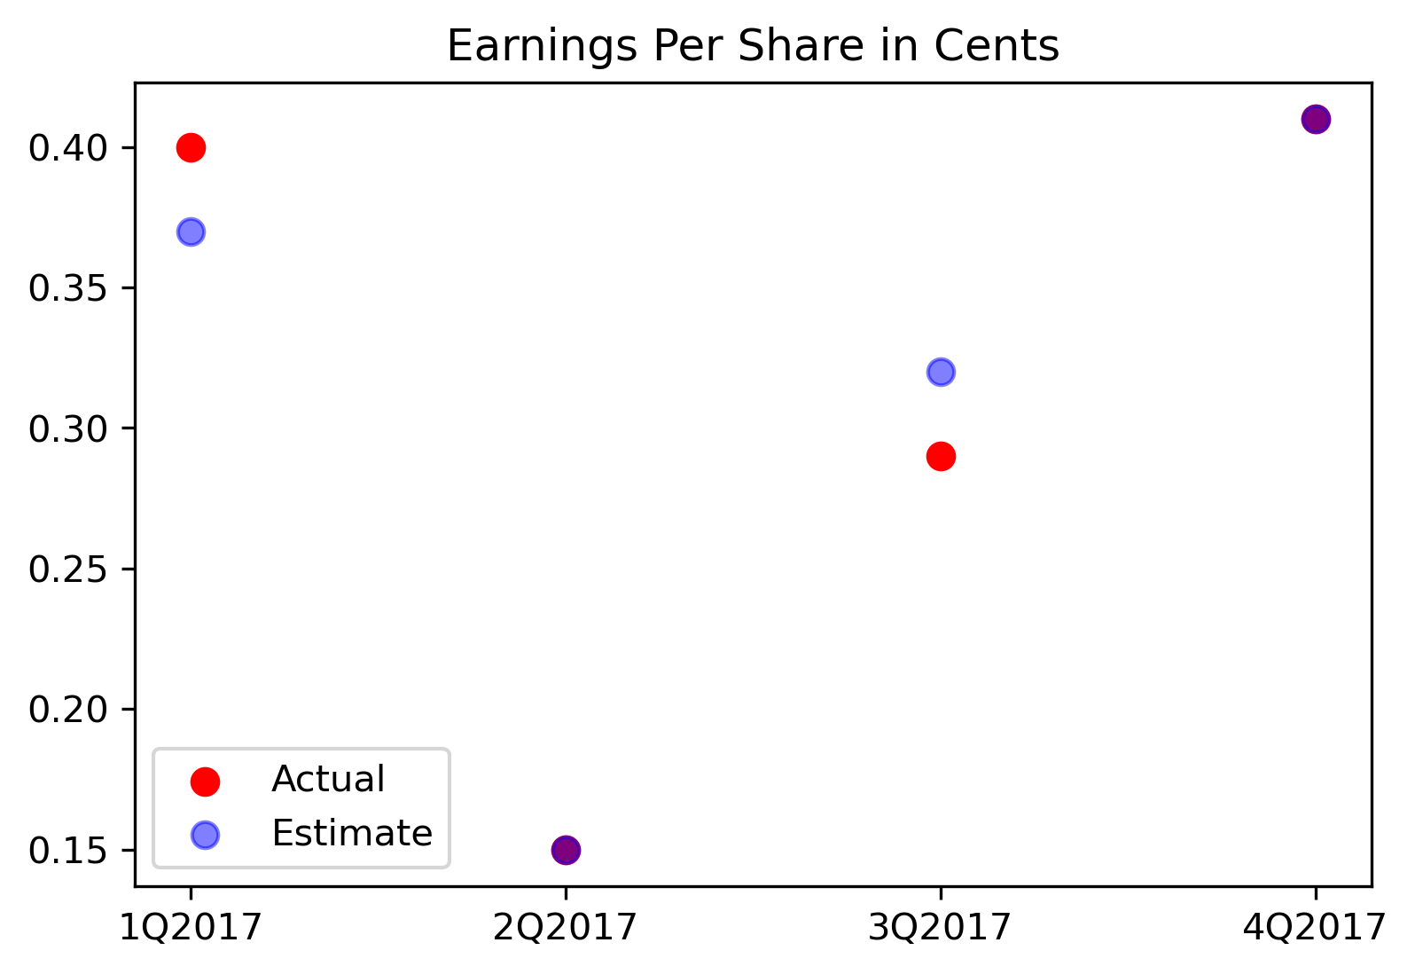
2017 Quarterly Earnings Per Share
Q2 and Q4 earnings per share were inline with estimates, while Q1 actual results outperformed and Q3 underperformed estimates.

Slide 5
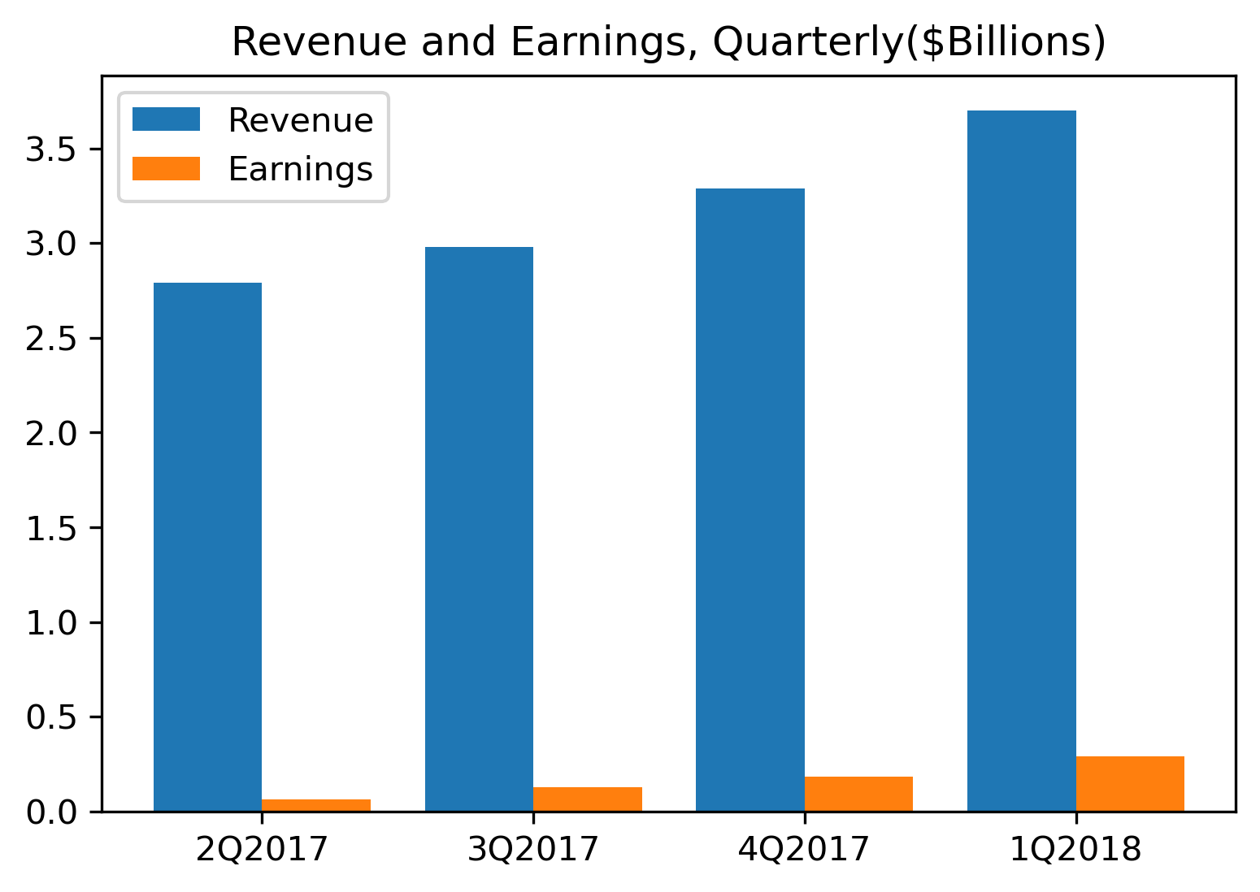
2017 Quarterly Revenue and Earnings
Revenue and Earnings trended upward nicely throughout the year with an average profit margin of 5.3%.

Slide 6
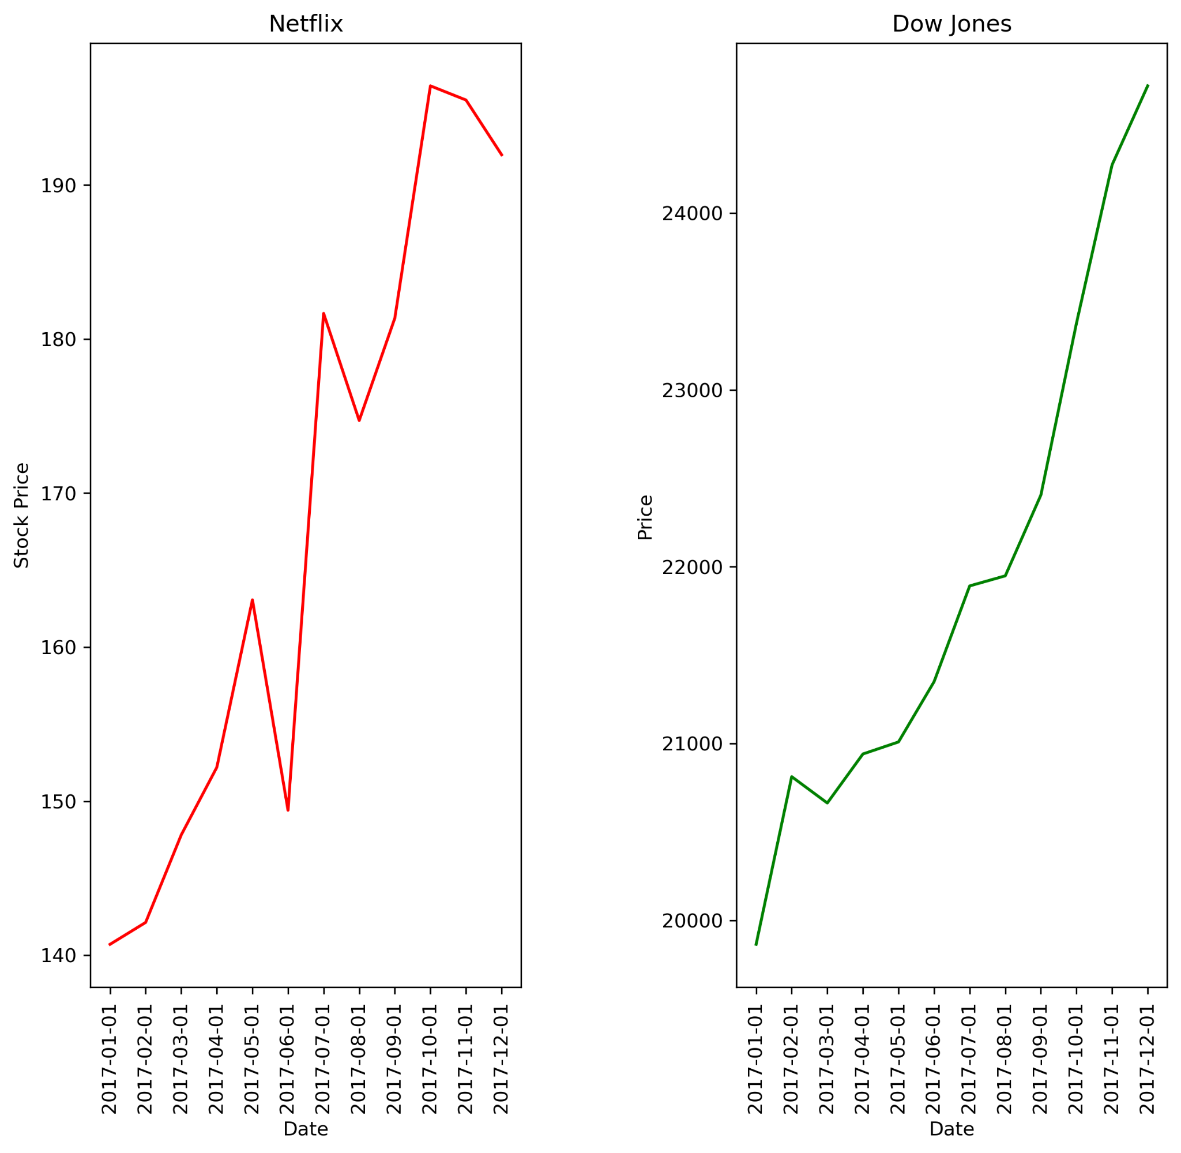
How has it performed compared to the Dow Jones in 2017?
Netflix outperformed the Dow increasing ~35% vs ~25%. But, it did so with more relative volatility having noticeable drawdowns in May/June, July/August, and at the end of the year in November and December.

